Slide 1
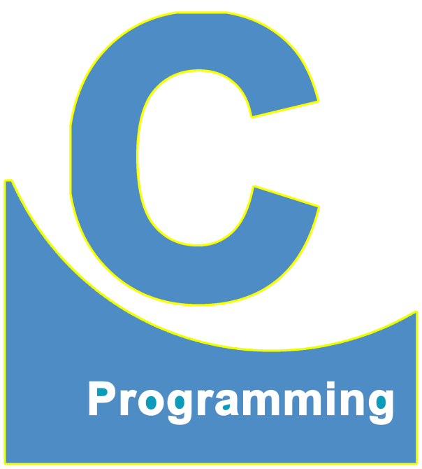
01
02
C Language
Lecture 5
04

Slide 2


Today’s Agenda
01
Compilation of The Program
02
What is Syntax Error ?
03
What is Runtime Error & Warning ?
03
Executing a C Program

Slide 3
Compilation of The Program
What do you mean by compilation ?
The word compilation means converting our program from source code to
the corresponding MACHINE CODDE.
This is because, our program in C programming language which is a
HIGH LEVEL LANGUAGE, but the CPU can only understand MACHINE CODE.
Thus unless we convert our HIGH LEVEL CODE to MACHINE CODE, the
Program cannot be executed.

Slide 4
Compilation of The Program
How do you compile the program in Turbo Compiler ?
There are 3 way to compile our code in TC:
1. By using the COMPILER menu bar
2. By using ALT+Keyboard shortcut options
3. By using ALT+F9

Slide 5
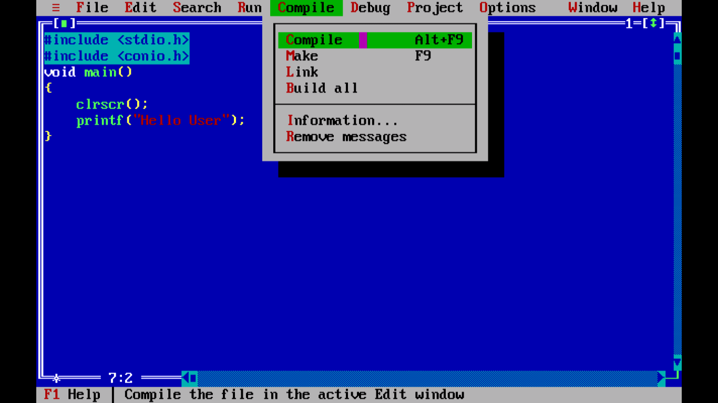
Compilation of The Program
Here you can see compiler option in Turbo C

Slide 6
What is Syntax Error ?
What happens when we compile a program ?
Whenever we compile a program, the compiler does 2 things:
A. The compiler searches our program or checks our program for errors.
These errors are called as SYNTAX ERROR. This is because the word
SYNTAX in programming means RULES/GRAMMAR of the language and if these rules are broken, the error which gets generated is called as
SYNTAX ERROR.

Slide 7
What is Syntax Error ?
B. If our program does not contain any kind of SYNTAX ERROR, only then
the compiler convert our SOURCE CODE (Expanded Source Code in C/C++) to the corresponding MACHINE CODE (Binary Code)
If the code contains even a SINGLE SYNTAX ERROR, then the compilation
stops and no MACHINE CODE gets generated.

Slide 8
What is Runtime Error ?
Do we have other kind errors also, other than SYNTAX ERRORS ?
Definitely, we have another category of errors and they are called as
RUNTIME ERRORS which are more dangerous and have to be handled by
programmer himself not by the compiler.
For Example: A program showing wrong output, A program hanging very
frequently, Programming some illogical output etc.

Slide 9
What is Warning ?
What are warnings in programming ?
When we compile a C program there some suggestions which the compiler wants us to follow and these suggestions are called as WARNINGS.
However if a program contains any warning, still the program has been
compiled successfully and can be executed.

Slide 10
Compilation of The Program
Whenever the compiler compiles the program what information
we get on our screen ?
The compiler shows 3 things on our screen after compilation:
1. Errors
2. Warnings
3. No of Lines compiled

Slide 11
Executing a C Program
What is the meaning of execution and how do we run the code ?
To execute a program means, processing of its instructions by the OS and
CPU. In simple words we can say running/execution give us the output of
a program.
To run a program in TC we have 3 points:
A. By using RUN menu from the menu bar
B. By using ALT+R
C. By using CTRL+F9

Slide 12
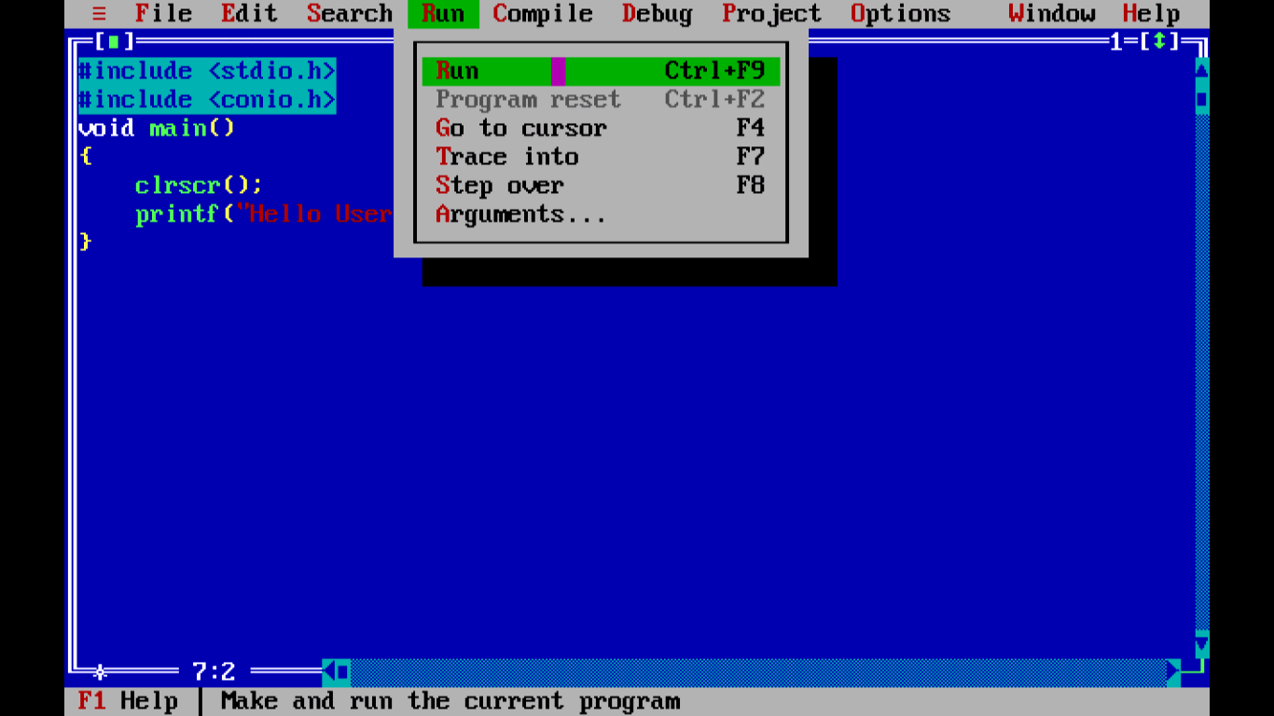
Executing a C Program
Here you can see run option in Turbo C

Slide 13
Executing a C Program
When we run a program, the output is always displayed on
CONSOLE window and to be able to view this window as well as the
corresponding output of the code we must press another key combination
which is ALT+F5.
Three Important Keyboard Shortcuts To Remember For Turbo IDE (TC):
Alt + F9 (Compile)
Alt + R (Run)
Alt + F5 (To open the console window)

Slide 14
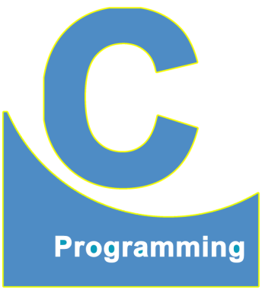
End of Lecture 5
For any queries mail us @: scalive4u@gmail.com
Call us @ : 0755-4271659, 7879165533
Thank you

